Slide 1
SUCI AULYA PUTRI
Data Mining Project
EDA (Exploratory Data Analysis) on E-commerce Behaviour Data from Multi-category Online Store
Using Python Programming

Slide 2
About
This project aims to gain consumer insight of a multi-category online store through Exploratory Data Analysis (EDA).
Various methods are utilised in order to obtain various angles and critically validate the analysis.

Slide 3
E-Commerce Behavior Data Dataset
E-Commerce
Is a business model that lets firms and individuals buy and sell things over the internet.
Dataset
The dataset contains behaviour data, collected by Open CDP project, from a large multi-category online store in October 2019. Each row in the file represents an event. All events are related to products and users. Each event is like many-to many relation between products and users.
Data Dictionary
event_time :Time when event happened at (in UTC).
event_type : Only one kind of event: purchase.
product_id : ID of a product
category_id : Product's category ID
category_code : Product's category taxonomy (code name) if it was possible to make it. Usually present for meaningful categories and skipped for different kinds of accessories.
brand : Downcased string of brand name. Can be missed.
price : Float price of a product. Present.
user_id : Permanent user ID.
user_session : Temporary user's session ID. Same for each user's session. Is changed every time user come back to online store from a long pause.
Behavioral data
Is data generated by, or in response to, a customer’s engagement with a business.
Source Data
https://www.kaggle.com/mkechinov/ecommerce-behavior-data-from-multi-category-store.

Slide 4
Business Question
How is the behavior of Visitors/Customers towards the goods available in the online store in October 2019?
What items are most viewed by visitors/customers in October 2019?
What brand of goods were purchased the most by Visitors/Customers in October 2019?
What is the average price of goods in the Online Store in October 2019?
How is the behavior of visitors at a specific time of the day
What is the best product to sell at a specific time of the day?
How is the behavior of our repeat user vs new user?

Slide 5
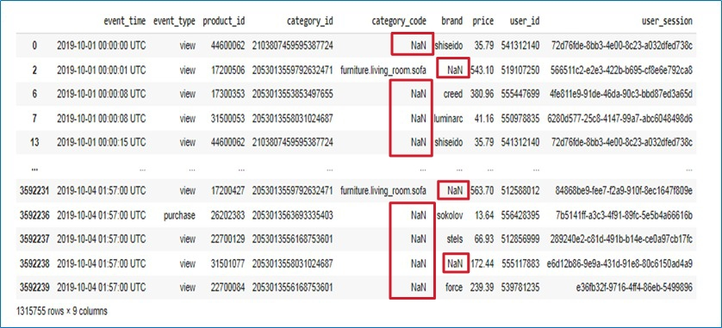
Checking Missing Data
The type of missing value there are NaN in several rows and columns.

Slide 6
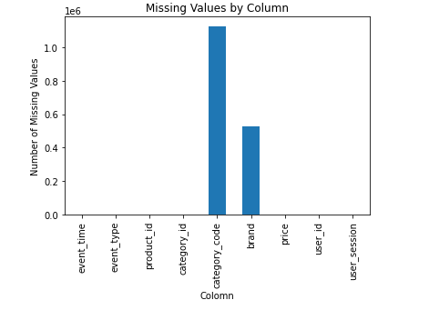
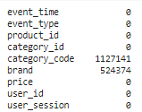
Visualization Missing Data
The most missing values are in the ‘category_code’ column, which is 1.127.141 missing values., followed by the 'brand' which is 524.374 missing values. These NA value will not be deleted so as to accurately asses the price distribution.

Slide 7
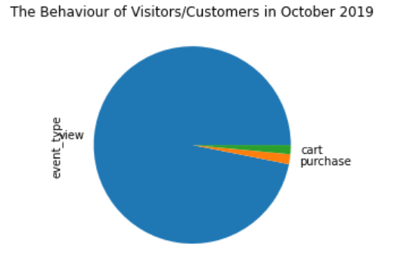

The Behaviour of Visitors/Customers in October 2019
In general, online shop visitors have a habit of viewing goods or add items to the cart but not yet certainly buy. Visitors/customers who buy goods at October 2019 totaled 58.402 visitors (1,63%).

Slide 8
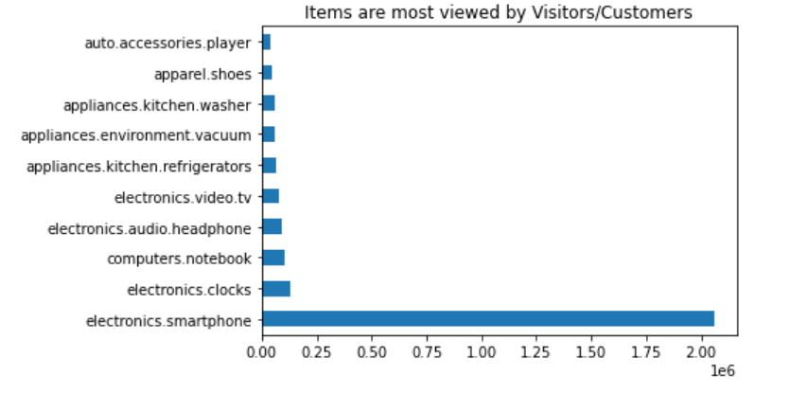
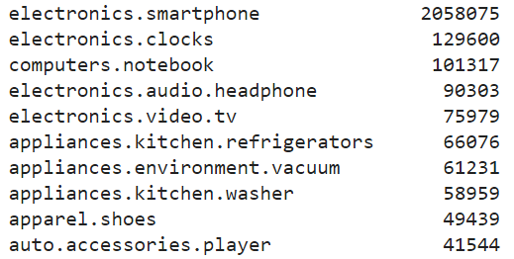
Items are most viewed by Visitors/Customers
The items most visited/viewed by online shop in October 2019 is electronics.smartphones.
Number of visited/viewed of items electronics.smartphones reached 2.058.075 units in October 2019.

Slide 9
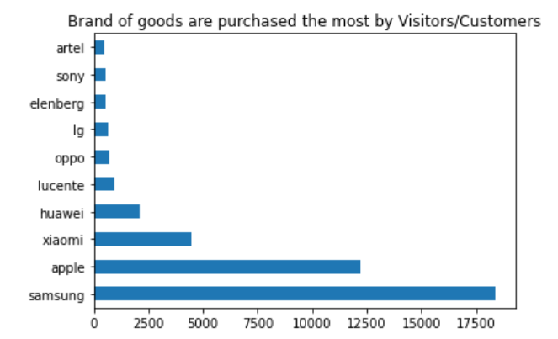
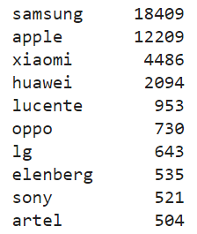
Brand of goods are purchased the most by Visitors/Customers
Samsung has become the brand that is most in demand by customers in October 2019. Number of purchases of brand goods Samsung reached 18.409 units in October 2019.

Slide 10
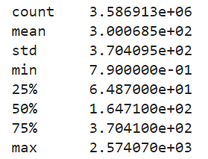
2.574,07
Price of goods in the Online Store in October 2019
To analyse the price distribution fairly, the products with 0 (zero) price tag are removed from the dataset because they do not weigh the same consideration when being purchased.
0,79
The highest item price in the Online Store in October 2019 was 2574.07
The lowest item price in the Online Store in October 2019 was 0.79
300,0685
The average price of goods in online stores in October 2019 is 300.0685.

Slide 11
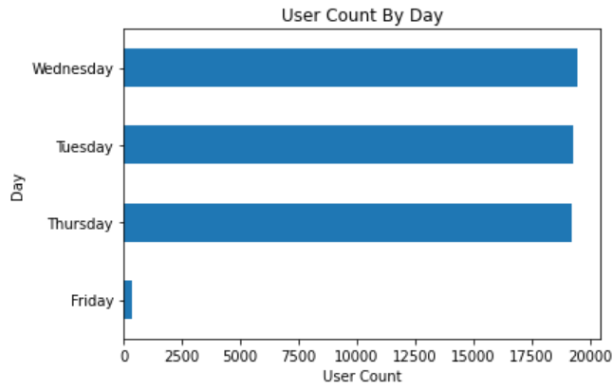
The behavior of visitors at a specific time of the day
Most consumers shop at e-commerce on Wednesday. Actually, consumers have seen the product since Tuesday.
After Tuesday consumers are still considering whether to buy or not. Besides that consumers are still comparing one product to another. The final decision to buy is mostly made on Wednesday. The e-commerce business team can provide a campaign to convince customers. The campaign can be intensified on Wednesday.

Slide 12
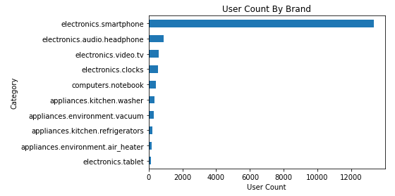
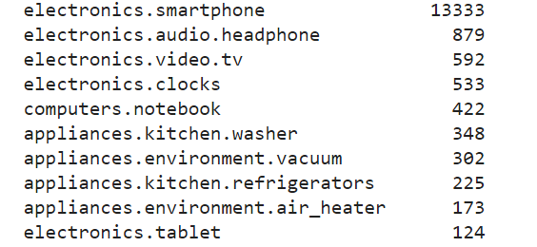
The best product to sell at a specific time of the day
electronics.smartphone has become the category_code that is most in demand at a specific time of the day by customers in October 2019.
Number of purchases of category_code goods electronics.smartphone reached 13.333 units in Wednesday.

Slide 13
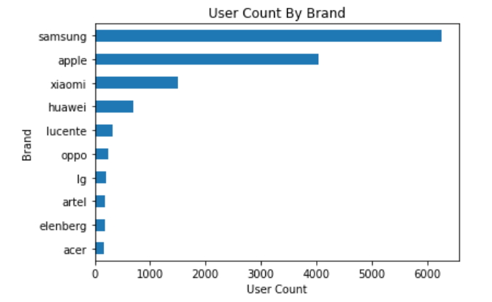
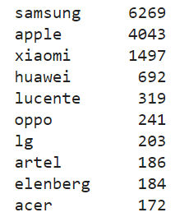
The best product to sell at a specific time of the day
Samsung has become the brand that is most in demand at a specific time of the day by customers in October 2019. Number of purchases of brand goods Samsung reached 6.269 units in Wednesday.

Slide 14
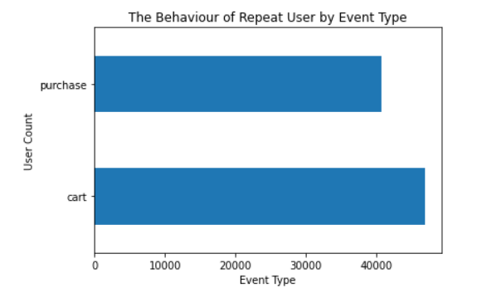
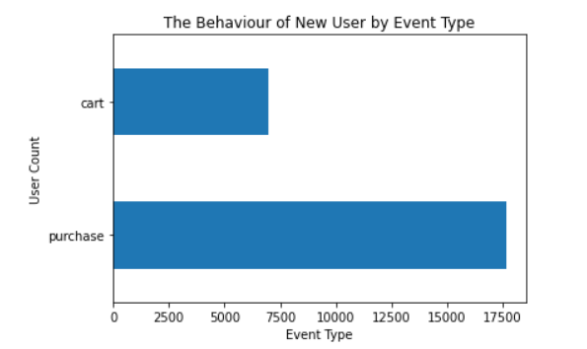
The behavior of our repeat user vs new user
Repeat User
New User
The difference between the behavior of new users and repeat users is that new users tend to purchase the product right away rather than adding the product to their cart. This is because new users when opening e-commerce only focuses on purchasing products. Whereas repeat users when opening e-commerce only to see the latest products, if like the products, repeat users tend to add products to the cart first, then repeat users are still considering buying or not and comparing one product with other products. If the product is as expected, repeat users will buy the product.

Slide 15
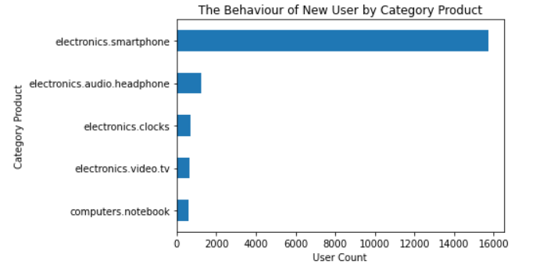
The behavior of our repeat user vs new user
Most new users buy electronics smartphone products.
The e-commerce business team can make promo of this product category to attract more new market users.

Slide 16
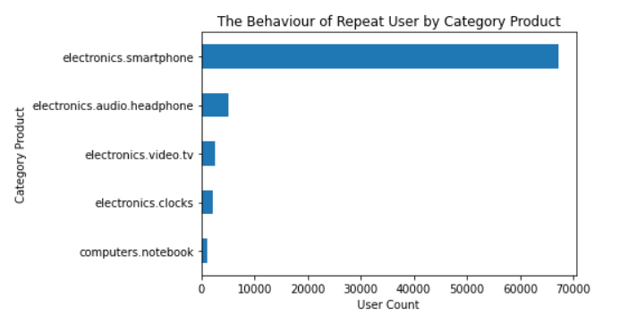
The behavior of our repeat user vs new user
Most repeat users buy smartphone electronics products.
Meanwhile product electronics audio headphones have a very large gap.
The e-commerce business team can make product bundling between electronics smartphone products and electronics audio headphones to increase profits from product categories that are still low in orders.

Slide 17
THANKS!

